Slide 1

CLOUD SECURITY FUNDAMENTALS
Course: Cloud Computing and Big Data Analytics
Guided By: Dr. A.M. Arul Raj
DONE BY:
ASWATHA V
SUSHMITHA S
Notes:
1
1

Slide 2
Aim and Objectives
The aim is to understand the fundamentals of cloud security.
It focuses on protecting cloud-based data and applications.
It explains different security models used in cloud environments.
It explains the responsibilities of providers and customers.
It identifies common security practices used in real-world systems.

Slide 3
Introduction
Cloud computing allows users to access data and applications over the internet.
Cloud security protects these resources from various cyber threats.
Unauthorized access can result in data loss and privacy issues.
Authentication ensures that only authorized users can access resources.
Encryption protects sensitive information from unauthorized use.

Slide 4
Core Technical
1. Identity & Access
IAM • MFA • Least privilege
2. Data Protection
Encryption • Key management • Backup
3. Network & App Security
Segmentation • Firewalls • Secure code
Identity and Access Management controls access to cloud resources.
Multi-Factor Authentication provides an additional layer of login security.
Encryption protects data during storage and transmission.
Firewalls control unwanted network traffic.
Security monitoring helps detect suspicious activities.

Slide 5
Existing System / Common Cloud Risks
Traditional systems mainly depend on locally managed security infrastructure.
Security management requires regular manual maintenance.
Scaling security becomes difficult when the number of users increases.
Hardware failures can affect application availability.
Organizations are responsible for managing most security components.

Slide 6
Proposed System
The proposed system uses cloud-based security mechanisms.
It provides controlled access through IAM and authentication.
It protects sensitive data using encryption techniques.
It continuously monitors activities to detect security threats.
It provides backup and recovery mechanisms for data protection.

Slide 7
System Architecture
CUSTOMER
• Data & classification
• Identities / IAM
• Applications & code
• Configurations
• OS & patches (IaaS)
• Network controls
• Monitoring
CLOUD PROVIDER
• Physical datacenter
• Physical network
• Hardware
• Hypervisor
• Managed platform
• Infrastructure security
SHARED
RESPONSIBILITY
Security controls
vary by service model
IaaS → PaaS → SaaS

Slide 8
Real-world Use Case in Cloud Computing
Scenario
E-commerce application
Cloud Services
Compute + Database + Storage
Security Controls
IAM + Encryption + Monitoring
Banks use cloud security to protect financial and customer information.
Hospitals use cloud security to protect patient records.
E-commerce platforms use cloud security to protect customer data.
Educational institutions use cloud security to protect student information.
Government organizations use cloud security to protect public services and records.

Slide 9
Conclusion & Key Takeaway
Cloud security is essential for protecting modern cloud environments.
Authentication and authorization prevent unauthorized access.
Encryption protects sensitive data from security threats.
Monitoring helps organizations identify and respond to attacks.
The Shared Responsibility Model improves overall cloud security.

Slide 10
References
NIST SP 500-291 – Cloud Computing Standards Roadmap
NIST SP 500-292 – NIST Cloud Computing Reference Architecture
Amazon Web Services – Shared Responsibility Model
Microsoft Learn – Shared Responsibility in the Cloud
AWS Well-Architected Framework – Security Pillar
Accessed: October 2026

Slide 11
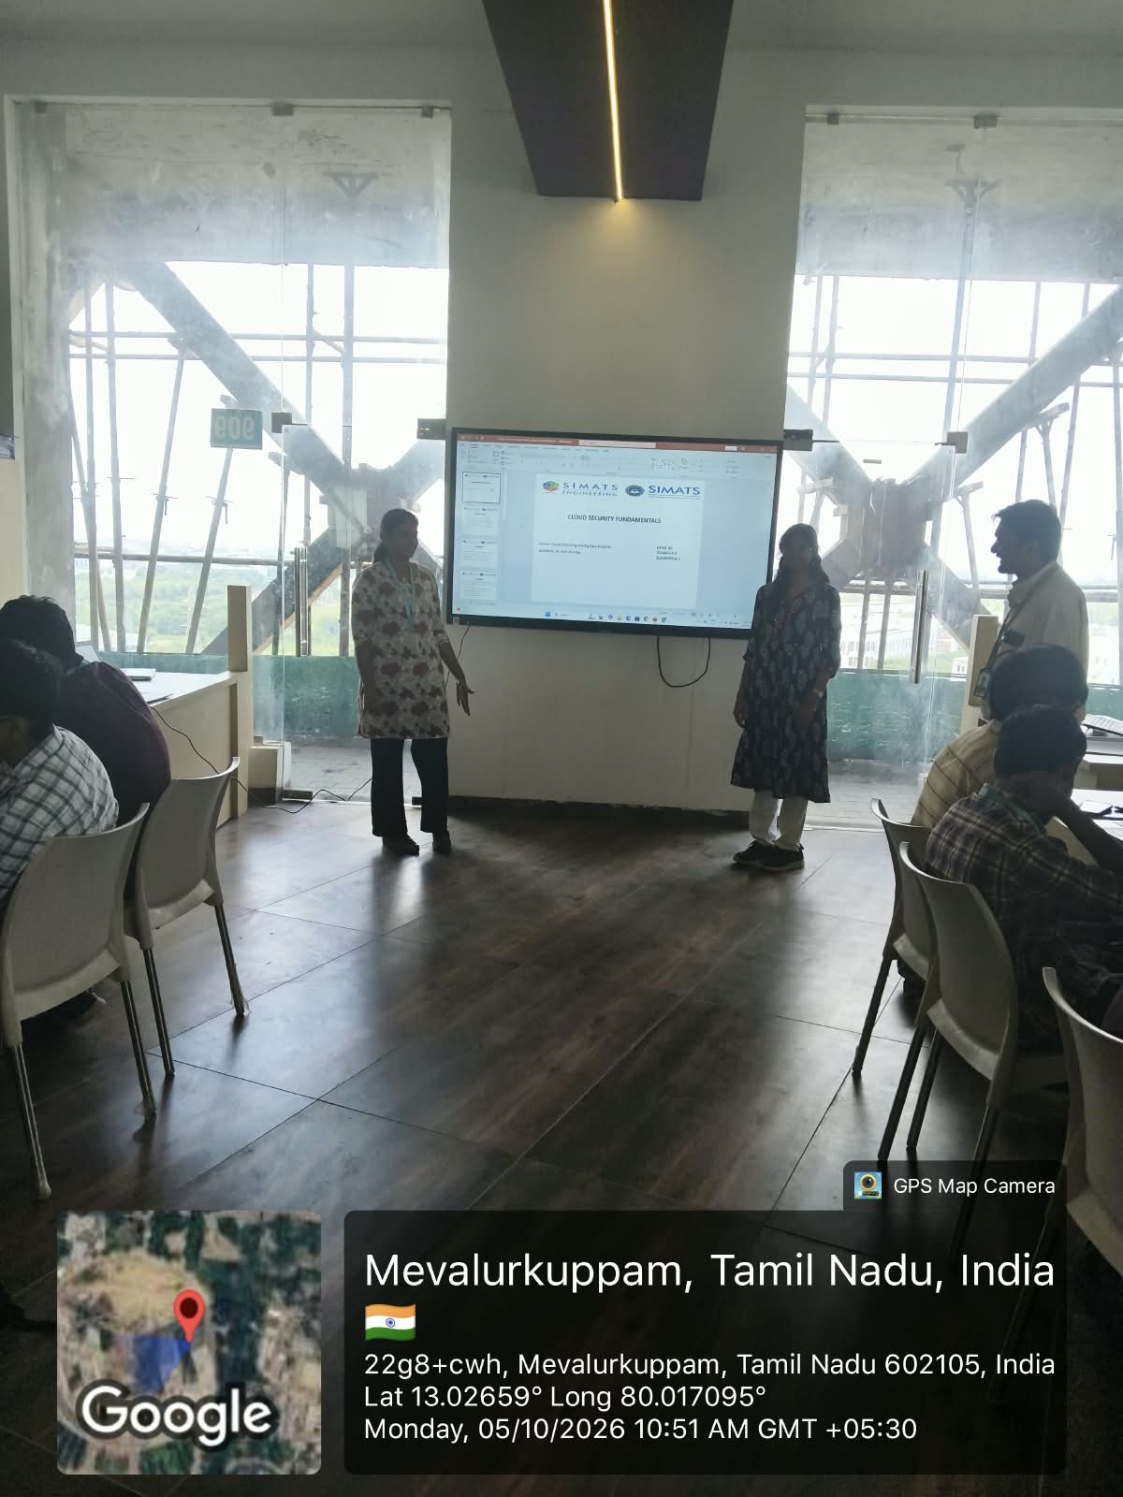

Slide 12
Thank You

